Slide 1
SAP Gateway
One Technology, a World of Experiences
Strictly for internal use

Slide 2
Day 1A

Slide 3
SAP Gateway
Day I Agenda
What is SAP Gateway
SAP Gateway Overview and Architecture
SAP Gateway Deployment Options
What is OData? Metadata and Queries of OData
What is REST Architecture?
How to format different OData URI’s?
Prerequisites which needs to be checked in Gateway System
Introducing Service Builder Tool

Slide 4
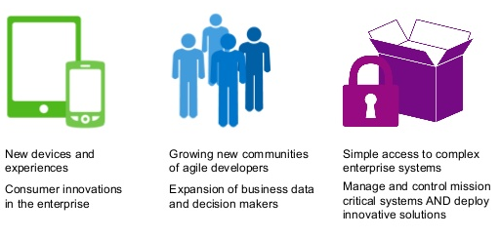
SAP Gateway
What is SAP Gateway?
- Any Environment, Any Device, by Any Developer
SAP Gateway lets you empower users with secure, personalized solutions that leverage and extend your existing SAP infrastructure, all with security, robustness, agility, and efficiency. SAP Gateway lets you meet the changing needs of your business at the speed of business by enabling People agility, System agility and Process agility.

Slide 5
Capabilities of SAP Gateway
Open - Any Device, Any Experience, Any Platform
People - Optimized for User Interaction Scenarios
Timeless - Non disruptive, any SAP Business Suite version
Developers - Simple APIs, no SAP knowledge, any tool
Opening the doors for millions of developers to create solutions connecting to SAP
Increase workforce productivity
Reduces Complexity , skill set requirements and deployment barriers
Shorten development times/cycles
Engage all developers with their choice of development tools
It offers connectivity to SAP applications using any programming language

Slide 6
Different Levels of Gateway Security
Different Security Level in SAP Gateway?
- Browser Based SAML 2.0 Authentication
- x.509 Client Certificate authentication
- SAP Logon tickets(SSL)
- Basic Authentication

Slide 7
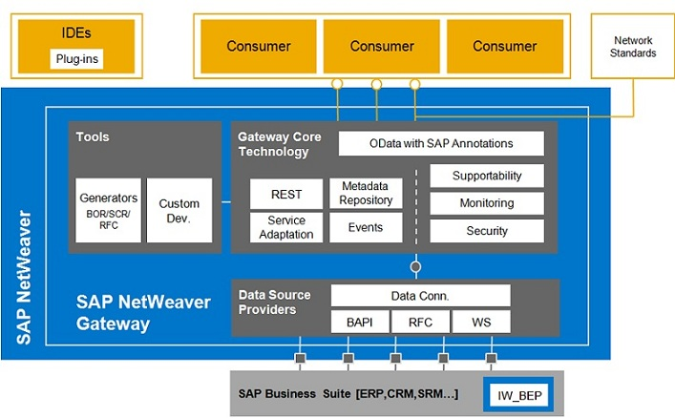
SAP Gateway Architecture

Slide 8
Deployment Options:
HUB Architecture:
Gateway server functionalities are only used on one dedicated server, the hub system. The services are deployed on the backend systems and are registered on the server. The Gateway service is thus deployed in the Gateway backend systems where either IW_BEP is deployed systems or that are running on top of 7.40 leveraging the core component SAP_GWFND.
Embedded Architecture:
In this case the services are registered as well as published in the SAP Business Suite backend system.

Slide 9
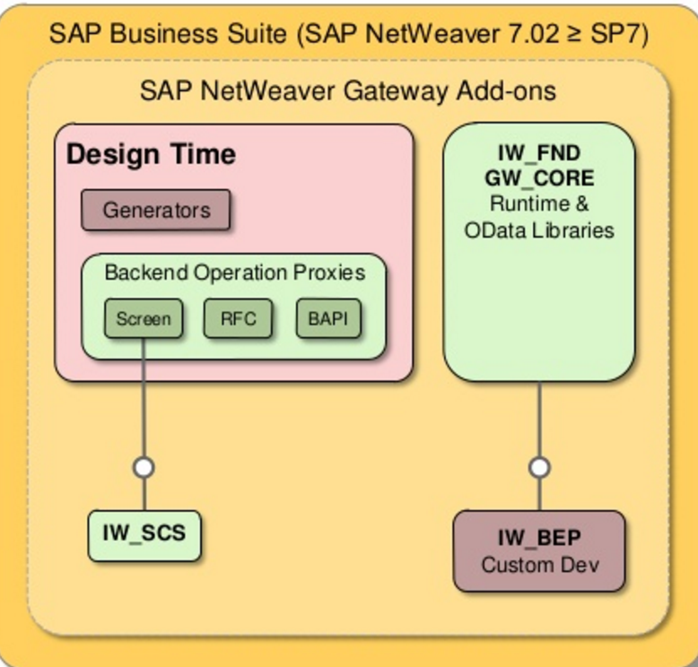
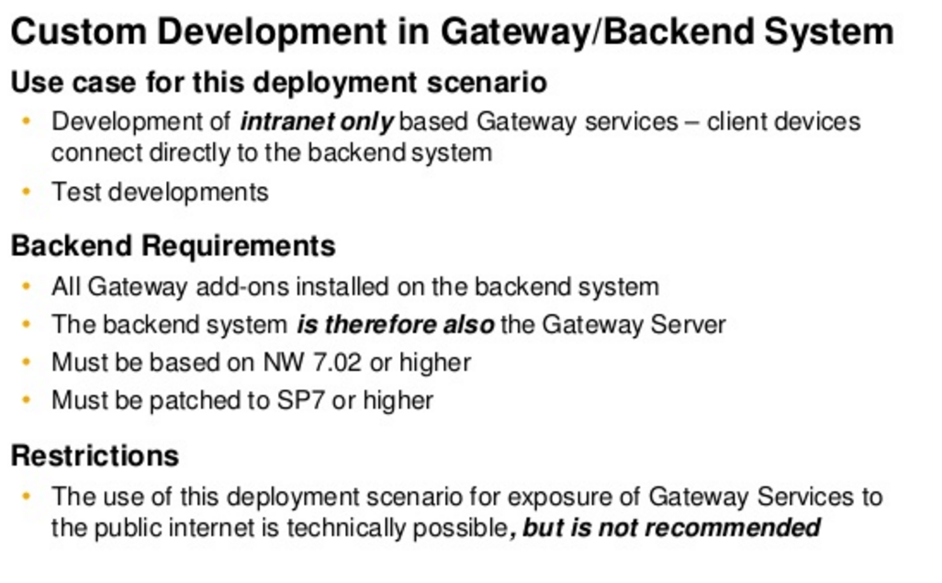
SAP Gateway Deployment Options GWB-OVW:GWB-OVW-02
There is two main scenario for SAP GW deployment: Embedded Deployment and Central hub Deployment.
Embedded deployment
The core software components for SAP NetWeaver Gateway Any optional backend components are deployed together in the SAP Business Suite backend System. In others words, Both Add-ons IW_BEP & IW_FND are installed to the SAP Business Suite Backend.
This SAP GW scenario is recommended for business-case where changing SAP Business Suite is hard or not preferred.

Slide 10
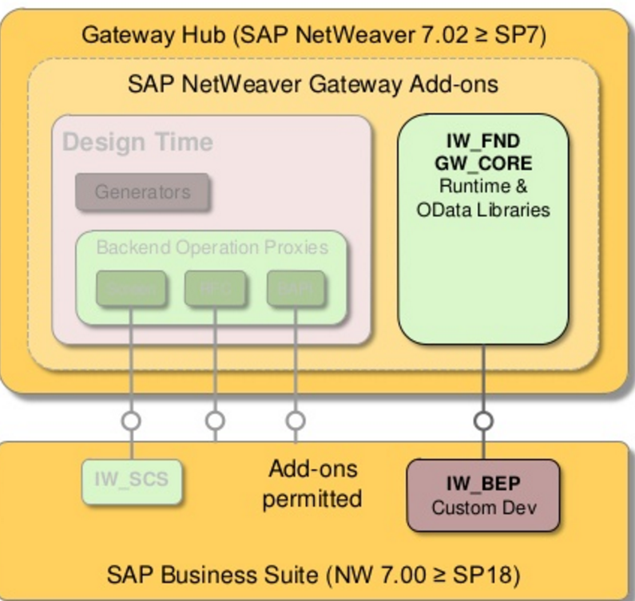
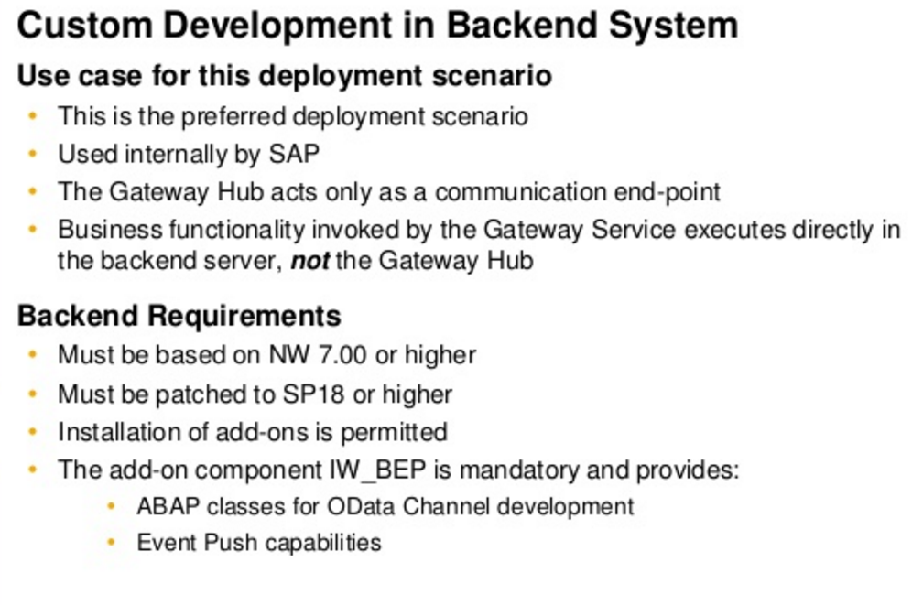
SAP Gateway Deployment Options GWB-OVW:GWB-OVW-02
Central hub deployment
The SAP NetWeaver Gateway core software components can be deployed in a standalone system, either behind or in front of the firewall. In addition, you can install the optional components for central hub deployment in your standalone system.
IW_BEP : Provides all the mandatory tools to develop and maintain GW Services
IW_FND: Provides the conversion and formatting
This scenario is the recommended one in term of deployment and performance.

Slide 11
Versions
SAP Netweaver Gateway 1.0
SAP Netweaver Gateway 2.0
SP01
SP02
SP03
SP04
SP05
SP06
SP07
SP08
SP09
SP10
SP11
SP12( Latest )
From SP4, SAP has newly introduced Gateway Service Builder Tool

Slide 12
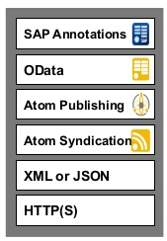
What is Odata?
OData is Microsoft developed extension to the Atom Publishing and Atom syndication Standards, which in turn are based on XML and HTTP(S).
It is Standardized protocol, built over existing HTTP and REST protocols supporting CRUD(Create, Read, Update and Delete) operations.
We can call it as ODBC Web.
It can be used freely without the need for a license or contract.
It uses ATOM+XML or JSON.
REST-based architecture.
For more information, please refer below link:
http://www.odata.org/

Slide 13
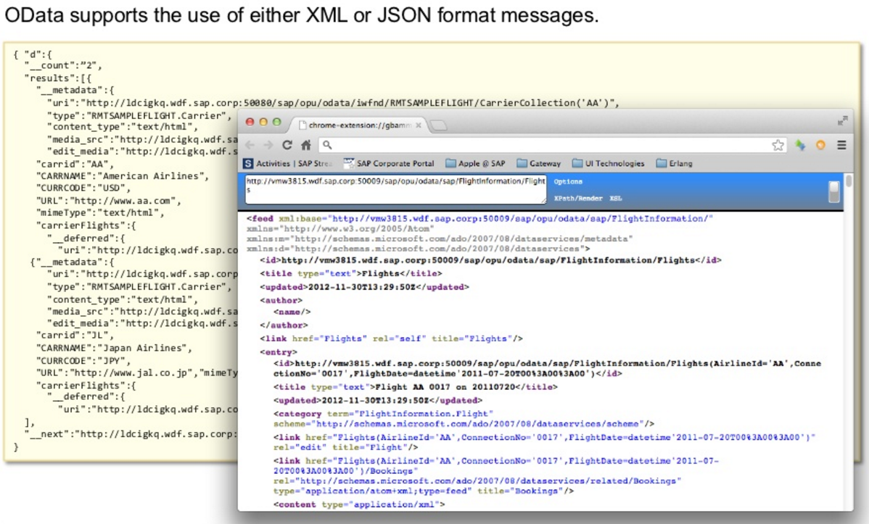
Output Formats Supported by OData
It supports XML and Json formats
XML - Hyper Text Mark up Language
JSON - JavaScript Object Notation
Reference Links:
http://www.odata.org/documentation/odata-version-2-0/json-format/
http://www.odata.org/documentation/odata-version-2-0/atom-format/

Slide 14
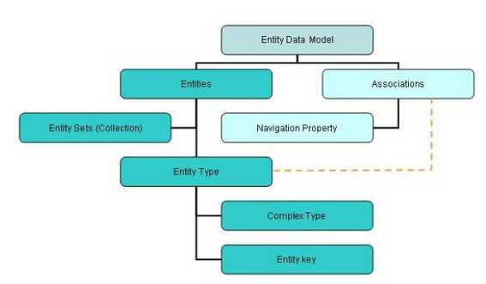
Metadata of OData
The metadata of OData message can be summarized as follows.
Refer to this blog: http://www.odata.org/

Slide 15
REST Architecture
REST is an architectural framework and methodology which is based on addressability, statelessness, connectedness and uniform interface.
OData is an implementation of REST.
HTTP(S) – An Implementation of the REST constraints:
HTTP(S) is the protocol that drives the World Wide Web
A Server-side resource can be manipulated in four basic ways.
These four basic REST operations have given rise the acronym CRUD.
REST Operation | HTTP Method
Create Resource | POST
Retrieve one or more Resources | GET
Update Resource | PUT
Delete Resource | DELETE

Slide 16
Differences
REST(Gateway Services) | SOAP ( Web services )
Limited Bandwidth and Resources & more suited for light weight apps | Higher Bandwidth and Heavy Weight
Stateless Operations | Statefull Operations
Caching is Possible | Caching is not Possible
No Asynchronous Support | Asynchronous processing and invocation
Communicate only over HTTP/HTTPS | Communicate over web, email, private networks
Formats like XML and JSON supported | Only XML is supported
It's a style | It's a industry standard
Resource Action

Slide 17
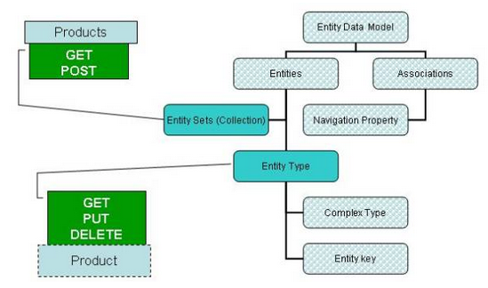
Possibility operations
We can do a GET and POST request on an Entity Set while GET, PUT and DELETE can be done on an Entity.

Slide 18
Definitions
An Entity type can be considered as data type that contains details of specific type of data.
For example: Customer, Supplier, Sales Order, Employee etc.
Entity Key is used to uniquely identify an Entity Type.
For example: Employee number , Sales Order number
An Entity set is nothing but a collection of Entity type.
Association is simply relation ship between two or more Entity types
For example: Products to its Manufacturer
(An entity set Product can be associated with an entity set Manufacturer in an OData metadata)
Navigation Property is a property set on an entity type to understand the associations of the entity type.

Slide 19
Queries of OData
$format : This query allows us to change the format of data.
URI: http://services.odata.org/OData/OData.svc/Suppliers?$format=json
$top : This query helps to limit the data returned by the service.
URI: http://services.odata.org/OData/OData.svc/Categories?$top=1
$Skip : This can be treated as opposite to $top.
URI: http://services.odata.org/OData/OData.svc/Products?$skip=2
$inlinecount : This will return the total number of records as part of response payload.
URI: http://services.odata.org/OData/OData.svc/Suppliers?$inlinecount=allpages
$orderby : It is used to sort the records returned by service.
URI: http://services.odata.org/OData/OData.svc/Products?$orderby=Price desc
$expand : This we found as very helpful query to reduce the number of calls we need to make to access a particular set of data. Say, if you want to return all the products along with their category, use the example
URI: http://services.odata.org/OData/OData.svc/Products?$expand=Category
$filter : This can be compared to ‘where’ query in SQL. Lets say we want to get all the products with greater than 3
URI: http://services.odata.org/OData/OData.svc/Products?$filter=Rating gt 3
$select : As is any SQL query, this query option can be used to select specific or all fields of an Entity set or Entity. A simple example, lets say the requirement for which is for us to return the fields rating and Price of a Product with ID = 3
URI: http://services.odata.org/OData/OData.svc/Products(3)?$select=Rating,Price

Slide 20
Prerequisites check in Gateway system
Check whether SAP Gateway is activated.
Check whether system alias is maintained.
Check whether Service maintenance is registered and maintain successfully.
Check, based on SP level where all SAP notes has been implemented which are recommended by SAP.
Check whether virus scan profile is deactivated or not.
Clear the cache when ever the services are regenerated.

Slide 21
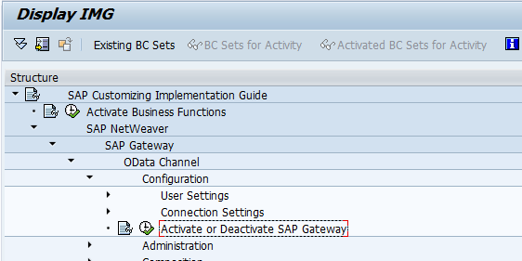
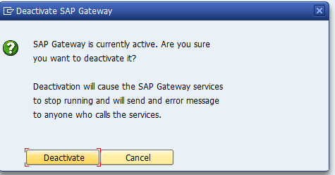
Prerequisites check in Gateway system
Check whether SAP Gateway is activated.
Go to Transaction SPRO => Click on SAP Reference RMG
Navigate to below path:
SAP NetWeaver=>SAP Gateway=>OData Channel=>Configuration=>Activate or Deactivate SAP Gateway

Slide 22
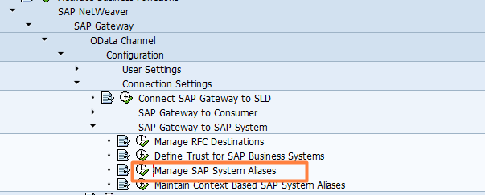
Prerequisites check in Gateway system – Contd..
Check whether system alias is maintained
Go to Transaction SPRO => Click on SAP Reference RMG
Navigate to below path:
SAP NetWeaver=>SAP Gateway=>OData Channel=>Configuration=>Connection Settings=>
SAP Gateway to SAP System=>Manage SAP System Aliases

Slide 23
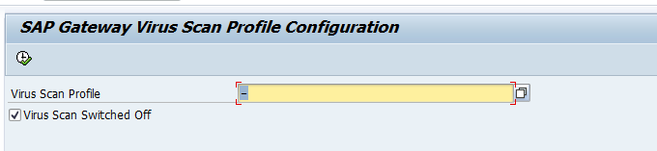
Prerequisites check in Gateway system – Contd..
Check whether virus scan profile is deactivated or not.
Transaction: /IWFND/VIRUS_SCAN
Clean up the cache when ever the services are regenerated.
Transactions:
/IWFND/CACHE_CLEANUP - Frontend Gateway System
/IWFND/CACHE_CLEANUP - Backend System

Slide 24
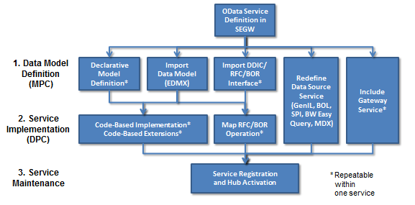
Gateway Service Builder Tool
Gateway Service Builder (transaction "SEGW") is available as of Release 2.0 Support Package 4/5 and it greatly accelerates the OData service development process. In many cases you don't even need to write a single line of ABAP code - unless of course you prefer to do so. It is no longer mandatory that you have deep ABAP OO skills.
In Service Builder we need to do follow below three steps to build an OData service:
Define or import the data model
Implement or generate the runtime logic for the service operations
Activate and run the service
The picture shows the various options
that are covered in SEGW:

Slide 25
Definitions
An Entity type can be considered as data type that contains details of specific type of data.
For example: Customer, Supplier, Sales Order, Employee etc.
Entity Key is used to uniquely identify an Entity Type.
For example: Employee number , Sales Order number
An Entity set is nothing but a collection of Entity type.
Association is simply relation ship between two or more Entity types
For example: Products to its Manufacturer
(An entity set Product can be associated with an entity set Manufacturer in an OData metadata)
Navigation Property is a property set on an entity type to understand the associations of the entity type.

Slide 26
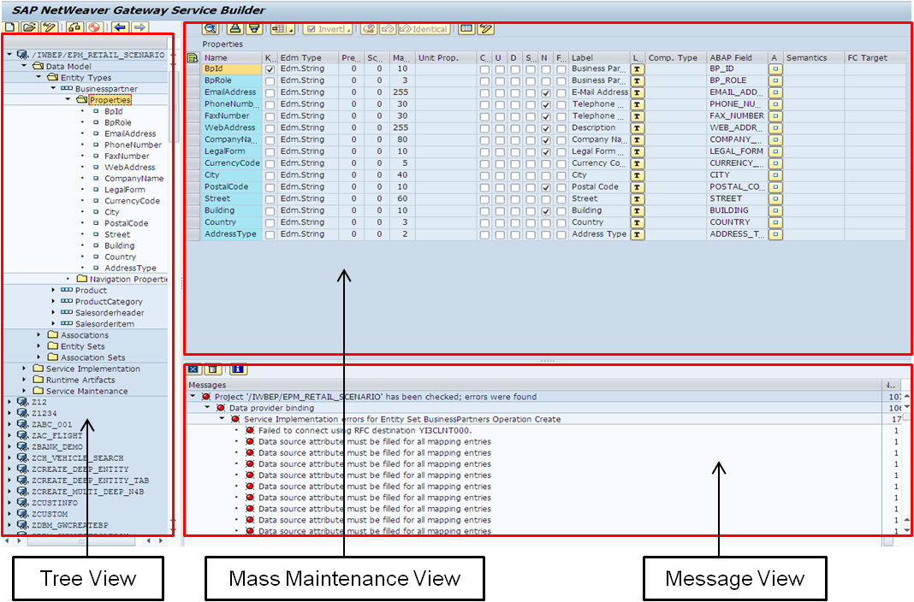
SEGW
Transaction Code : SEGW
Design time environment which provides developers an easy-to-use set of tools for creating services
Need to understand below terms in SEGW transaction
- Entity Type
- Entity Set
- Association
- Navigation
- MPC( Model Provider Class )
- DPC( Data Provider Class )
By now we should be familiar of all above terms in Gateway
Service Builder.

Slide 27
Service Operations
Service Operations:
- GetEntity
we can refer to as work area in ABAP
- GetEntitySet
we can refer to as internal table in ABAP
- Create
We can create only single record at once.
- Update
We can single only record at once.
- Delete
We can delete only single record at once.

Slide 28
How to format OData URI’s
More examples:
Get me the three of the best rated products
URI: http://services.odata.org/OData/OData.svc/Products?$top=3&$orderby=Rating desc
Now get me the next three best rated products.
URI: http://services.odata.org/OData/OData.svc/Products?$top=3&$skip=3&$orderby=Rating desc
Get me the count of Products with the Price greater than or equal to 20?
URI: http://services.odata.org/OData/OData.svc/Products?$inlinecount=allpages&$filter=Price ge 20

Slide 29
Important Transactions
SPRO
SEGW
/IWFND/MAINT_SERVICE
/IWFND/GW_CLIENT
/IWFND/ERROR_LOG
IWFND/CACHE_CLEANUP
/IWBEP/CACHE_CLEANUP
/IWFND/VIRUS_SCAN
/IWFND/TRACES
/IWFND/SERVICE_TEST
/IWFND/EXPLORER
/IWFND/IWF_ACTIVATE
/IWFND/SERVICE_TEST
/IWFND/VIEW_LOG

Slide 30
Questions and Answers
Is JSON supported?
Yes, JSON is supported for all the service operations, but it does not supports for metadata.
Components which needs to be installed in Embedded Architecture?
If it is SAP Net weaver 7.0,7.01,7.02,7.03 below components should be installed
IW_BEP, GW_CORE, IW_FND.
If it is SAP Net weaver 7.40 or higher, SAP provides default SAP_GWFND.
You can deactivate caching from
SPRO -->Gateway -->OData Channel -->Administration -->Cache Setting -> Metadata . Also you will find some more options for Cache here
How to activate/deactivate virus scan profiles?
/IWFND/VIRUS_SCAN
Maintain System alias
SPRO->SAP Netweaver ->Gateway Service Enablement->Connection settings to SAP Netweaver Gateway->SAP Netweaver Gateway Settings.
SPRO->SAP Netweaver ->OData Channel->Connection settings->SAP Netweaver Gateway to SAP system->Manage system alias.

